Slide 1
Chapter 2: The Second Law
Curtesy of M. Jackson
Additions and modifications by Dr. Tariq Gilani

Slide 2
Ch 2: The Second Law
In Ch 1, it was first law applied to thermodynamics and introduced concept of heat, work and temperature.
However, some fundamental questions remain unanswered
What really is the temperature?
Why does heat flow spontaneously from hotter to cooler object and never the other way?
More general question
Why do so many thermodynamic processes are irreversible?
Brief answer:
Irreversible processes are not inevitable; they are just overwhelmingly probable.
Example: when heat flows from a hotter object to cooler, the energy is moving around randomly. After some time, the very high probability is that we will find energy distribution more uniformly distributed among all parts of the system.
Temperature is the way of quantifying the tendency of energy to enter or leave an object during the random arrangements.
Therefore, we need to study how a system stores energy and learn how to count all the ways that energy might be arranged
Math of counting ways of arranging things is called Combinatorics

Slide 3
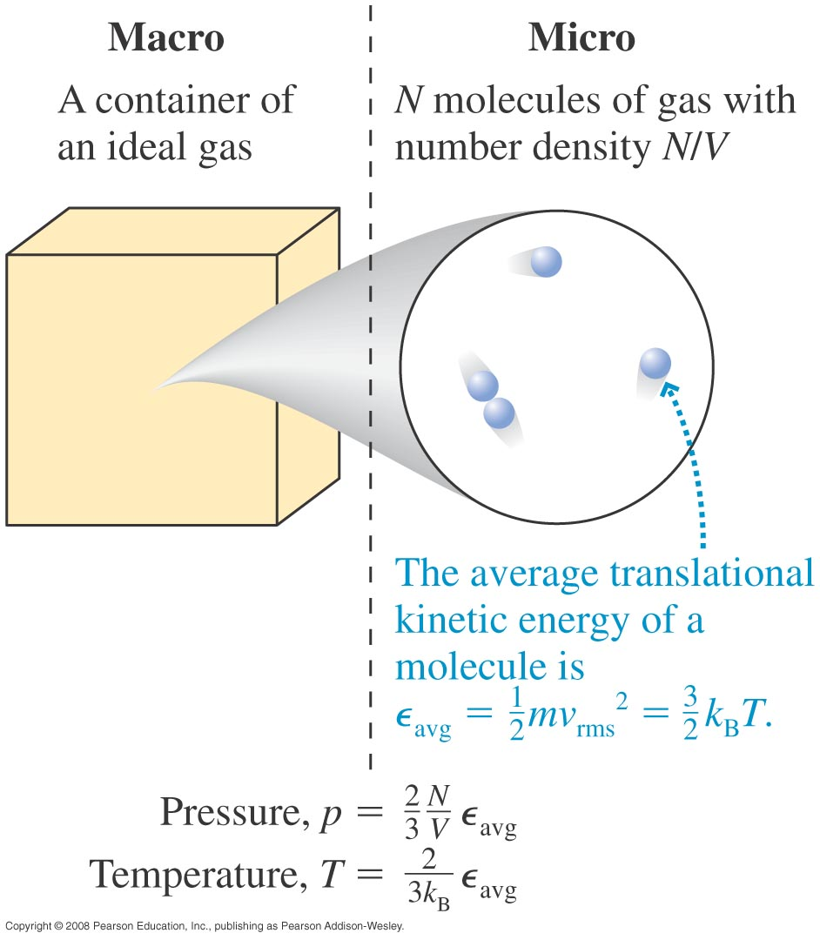
Macrostates and Microstates (Ch. 2 )
Combinatorics is basic statistic mechanics
In other words, we need to learn the relationship between macrostates and microstates
The macro/micro connection
Statistical mechanics is a bridge from microscopic states to averages
This path will bring us to the concepts of entropy and the second law of thermodynamics.

Slide 4
Two-State Systems
When there are only two possible outcomes
How man possible outcomes?
8
Let’s flip three coins
 | Penny | Nickel | Dime
1 | H | H | H
2 | H | H | T
3 | H | T | H
4 | T | H | H
5 | H | T | T
6 | T | H | T
7 | T | T | H
8 | T | T | T
Microstate = each of the eight different outcomes
To specify the microstate of a system, we must specify the state of each individual particle (the state of each coin).
If we state generally, by saying how may heads/tails are there, we are stating a macrostate
If you know the microstate of a system, you also know its macrostate (say HHT)
$$Ω\left(3 heads\right)=1$$
$$Ω\left(2 heads\right)=3$$
$$Ω\left(1 heads\right)=3$$
$$Ω\left(0 heads\right)=1$$
But the reverse is not true: Knowing that there are exactly two “heads” does not tell the state of each coin (there are 3 microstates corresponding to this macrostate).

Slide 5
 | Penny | Nickel | Dime
1 | H | H | H
2 | H | H | T
3 | H | T | H
4 | T | H | H
5 | H | T | T
6 | T | H | T
7 | T | T | H
8 | T | T | T
flipping three coins
Multiplicity of a macrostate = the number of microstates corresponding to a given macrostate.
Examples of macrostates
State with 3 heads (or zero tail)
$$Ω\left(3 heads\right)=1$$
State with 2 heads (or 1 tail)
$$Ω\left(2 heads\right)=3$$
Total number of 8 microstates
State with 1 heads (or 2 tails)
$$Ω\left(1 heads\right)=3$$
State with 0 heads (or 3 tails)
$P(n)$=Probability of n heads $=\frac{Ω\left(n\right)}{Ω\left(all\right)}$
$$Ω\left(0 heads\right)=1$$
$\frac{Ω\left(2\right)}{Ω\left(all\right)}$ = $\frac{3}{8}$
Probability of 2 heads up, P(2)?

Slide 6
For a large number of coins
Consider 100 coins, each coin has 2 possible states
The total number of microstates is?
2¹⁰⁰
The total number of macrostates is?
101 (0 heads, 1 head, 2 heads,...)
What is the multiplicity of the macrostate???
$$Ω\left(0 heads\right)$$
$=1$ ; all coins are tails-up
$$Ω\left(1 heads\right)=100 ; it could be any one coin$$
$$Ω\left(2 heads\right)=?$$
$$there are 100 choices for the first coin and$$
$99 remaining choices for the second coin$.
But you can choose any pair in either order
Therefore, the number of distinct pairs is
$Ω\left(2\right)=$ $\frac{100∙99}{2}$
For 3 coins heads-up
$Ω\left(3\right)=$ $\frac{100∙99∙98}{3∙2}$
For n coins heads-up
$Ω\left(n\right)=$ $\frac{100∙99⋯\left(100−n+1\right)}{n⋯3∙2∙1}=\frac{100!}{n!\left(100−n\right)!}=\left(\begin{matrix}100 \\ n\end{matrix}\right)$

Slide 7
In general
Consider N coins, each coin has 2 possible states
The total number of microstates is 2^{N}.
Total number of macrostates is N+1.
Multiplicity of the macrostate with n heads (the number of “combinations” of n objects out of N) is:
$Ω\left(N,n\right)=$ $\frac{N!}{n!\left(N−n\right)!}=\left(\begin{matrix}N \\ n\end{matrix}\right)$

Slide 8
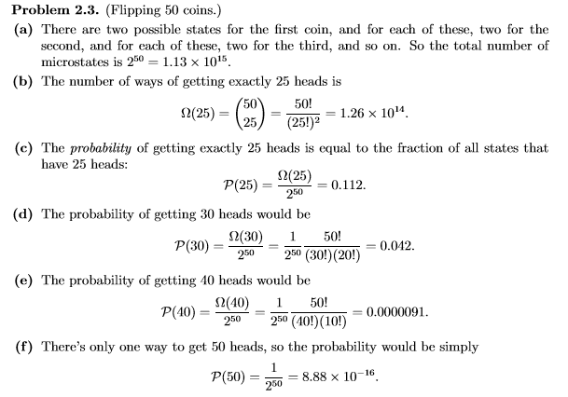
$Ω\left(N,n\right)=$ $\frac{N!}{n!\left(N−n\right)!}=\left(\begin{matrix}N \\ n\end{matrix}\right)$
$$P(n)=\frac{Ω\left(n\right)}{Ω\left(all\right)}$$
0! = 1

Slide 9
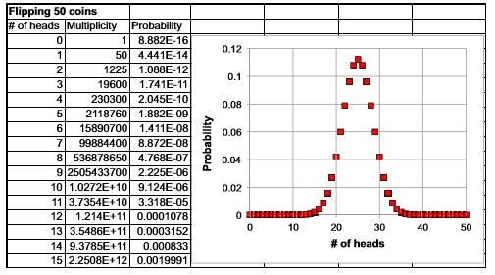

Slide 10
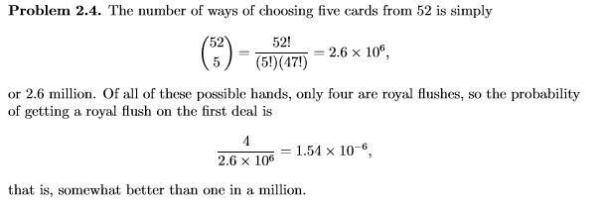

Slide 11
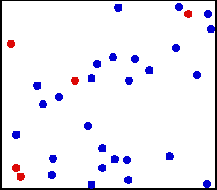
Microstates
The evolution of a system can be represented by a trajectory in the multidimensional (phase) space of micro-parameters. Each point in this space represents a microstate.
During its evolution, the system will only pass through accessible microstates – the ones that do not violate the conservation laws: e.g., for an isolated system, the total internal energy must be conserved.
Microstate: the state of a system specified by describing the quantum state of each molecule in the system. For a classical particle you need 6 parameters (x_{i} , y_{i} , z_{i} , p_{xi} , p_{yi} , p_{zi}), for a macro system – 6N parameters.

Slide 12
Statistics ⇒ Probabilities of Macrostates
The statistical approach: to connect the macroscopic observables (averages) to the probability for a certain microstate to appear along the system’s trajectory in phase space, P(σ ₁, σ ₂, ... , σ _{N}).
Macrostate: the state of a macro system specified by its macroscopic parameters.
Two systems with the same values of macroscopic parameters are thermodynamically indistinguishable. (multiplicit)
A macrostate tells us nothing about a state of an individual particle.
For a given set of constraints (conservation laws), a system can be in many macrostates.

Slide 13
Probability of a Macrostate, Multiplicity
The probability of a certain macrostate is determined by how many microstates correspond to this macrostate – the multiplicity of a given macrostate Ω.
This approach will help us understand why some of the macrostates are more probable than others, and, eventually, by considering the interacting systems, we will understand the irreversibility of processes in macroscopic systems.

Slide 14
The Two-State Paramagnet
All materials respond in some way to applied magnetic field
Paramagnet
A material in which constituent particles act like tiny compass needles (dipoles) that tend to align parallel to externally applied magnetic field.
If the constituent particles interact strongly with each other, the material can magnetize even without any external applied field – Ferromagnet
Dipole
Individual magnetic particles, each has its own magnetic dipole moment vector
For two-state paramagnet, dipoles are either parallel or anti parallel to applied field
$$\vec{B}$$
$$N=N_{↓}+N_{↑}$$
Let B = Applied magnetic field to N dipoles
N↑ - the number of “up” spins
N↓ - the number of “down” spins
N↑ = number of dipoles parallel to B
and $N↓$= number of dipoles anti parallel to B
A particular microstate (↑↓↓↑↓↑↑↓↓↓↑↓↑....) is specified if the directions of all spins are specified. A macrostate is specified by the total # of dipoles that point “up”, N↑ (or the # of dipoles that point “down”, N ↓ = N - N↑ ).

Slide 15
The Multiplicity of Two-State Paramagnet
Each of the microstates is characterized by N numbers,
The number of equally probable microstates = 2^{N},
The probability to be in a particular microstate = 1/2^{N}.
For a two-state paramagnet in zero field, the energy of all macrostates is the same (0). A macrostate is specified by (N, N↑).
Its multiplicity - the number of ways of choosing N↑ objects out of N :
$$Ω \left(N,n\right)=\frac{N×\left(N−1\right)×...×\left[N−\left(n−1\right)\right]}{n×...×3×2×1}=\frac{N!}{n!\left(N−n\right)!}=\left(\begin{matrix}N \\ n\end{matrix}\right)$$
n ! ≡ n factorial = 1·2·....·n
0 ! ≡ 1 (exactly one way to arrange zero objects)
The multiplicity of a macrostate of a two-state paramagnet with (N, N↑):
In Physics: specifying the macrostate of a system = specifying its total energy

Slide 16
μ - the magnetic moment of an individual dipole (spin)
The total magnetic moment:
(a macroscopic observable)
The energy of a single dipole in the external magnetic field:
$$ε_{i}=−{\vec{μ}}_{i}⋅\vec{B}$$
- μB for μ parallel to B,
+μB for μ anti-parallel to B
$$\vec{B}$$
E
E₂ = + μB
an arbitrary choice
of zero energy
0
E₁ = - μB
The energy of a macrostate:

Slide 17
Example
Consider two spins. There are four possible configurations of microstates:
M = 2μ 0 0 - 2μ
In zero field, all these microstates have the same energy (degeneracy).
Note that the two microstates with M = 0 have the same energy even when B ≠ 0: they belong to the same macrostate, which has multiplicity Ω = 2.
The macrostates can be classified by their moment M and multiplicity Ω:
M = 2μ 0 - 2μ
Ω = 1 2 1
For three spins:
M = 3μ μ μ μ -μ -μ -μ -3μ
M = 3μ μ - μ -3μ
Ω = 1 3 3 1
Macrostates:

Slide 18
Assignment#4 Due 2/24/2022
2.17, 2.19, 2.26, and 2.31 2.33.
Problems for practice on Friday:
2.1, 2.2, 2.5, 2.6, 2.8, 2.28, 2.32, and 2.36.
(These are all problems from this chapter)
Next: Einstein’s Model of solids, Interacting System, Entropy and 2nd Law

